Slide 1
Scientific Text Mining and Knowledge Graphs Chapter 2 Part 2: Knowledge Graph Learning
Presenter: Meng Jiang
University of Notre Dame
mjiang2@nd.edu
Notes:
Thank you for the introduction!
Good morning, everyone!
This is Jingbo Shang from UIUC. I’m very excited to share my research with you!
My talk today is mainly about AutoNet. Automated Network Construction from Massive Text Corpora.

Slide 2
Roadmap
Scientific KGs of COVID-19 literature
Learning scientific KG for literature search
Learning scientific KG for text generation

Slide 3
Roadmap
Scientific KGs of COVID-19 literature
Learning scientific KG for literature search
Learning scientific KG for text generation

Slide 4
Motivating Examples
Chloroquine
Vincent et al. 2005. Chloroquine is a potent inhibitor of SARS coronavirus infection and spread. Virology Journal.
氯喹
treatment
is effective
in preventing
spread
SARS-COV
infection
SARS-COV-2

Slide 5
Motivating Examples (cont’d)
Chloroquine
Vincent et al. 2005. Chloroquine is a potent inhibitor of SARS coronavirus infection and spread. Virology Journal.
“… The Chloroquine treatment is effective in preventing the spread of SARS-COV infection. …”
Quintuple: ( {Chloroquine ::: treatment},
is_effective_in_preventing,
{SARS-COV_infection ::: spread} )
氯喹
treatment
is effective
in preventing
[1]
spread
SARS-COV
infection
SARS-COV-2
[1] Jiang et al. 2019. The Role of “Condition”: A Novel Scientific Knowledge Graph Representation and Construction Model. SIGKDD.

Slide 6
Motivating Examples (cont’d)
Chloroquine
Hydroxychloroquine
Vincent et al. 2005. Chloroquine is a potent inhibitor of SARS coronavirus infection and spread. Virology Journal.
氯喹
sensitive to
treat
羟氯喹
treatment
The Coronavirus Infectious Disease Ontology (CIDO). The OBO Foundry, Ontobee, and NCBO.
“… Hydroxychloroquine is a medication used to treat malaria in areas where malaria remains sensitive to chloroquine. …” _{[Wiki]}
Tuples: (Hydroxychloroquine, treat, malaria)
(malaria, remains_sensitive_to, chloroquine)
is effective
in preventing
malaria
spread
[1]
SARS-COV
infection
SARS-COV-2
[1] Jiang et al. 2019. The Role of “Condition”: A Novel Scientific Knowledge Graph Representation and Construction Model. SIGKDD.

Slide 7

Motivating Examples (cont’d)
Chloroquine
Hydroxychloroquine
Vincent et al. 2005. Chloroquine is a potent inhibitor of SARS coronavirus infection and spread. Virology Journal.
氯喹
sensitive to
treat
羟氯喹
treatment
The Coronavirus Infectious Disease Ontology (CIDO). The OBO Foundry, Ontobee, and NCBO.
is effective
in preventing
malaria
?
FDA Warns Against Using Drugs Promoted By Trump After Reports Of ‘Poisoning And Death’ _{[Forbes 04/24/2020]}
https://www.forbes.com/sites/carlieporterfield/2020/04/24/fda-warns-against-using-drugs-promoted-by-trump-after-reports-of-poisoning-and-death
spread
SARS-COV
infection
SARS-COV-2

Slide 8
Motivating Examples (cont’d)
cysteine proteases cathepsin B and L (CatB/L)
Chloroquine
inhibit
inhibitor
inhibit
氯喹
treatment
氯化铵
is
is
camostat mesylate
ammonium
chloride
甲磺酸卡莫司他
is effective
in preventing
inhibit
inhibit
?
inhibit
TMPRSS2
spread
ACE2
express
express
SARS-COV
infection
of
Vero
E6 cells
be
primary entry cells
SARS-COV-2
is
in
Zhou et al. 2020. A pneumonia outbreak associated with a new coronavirus of probable bat origin. Nature 579, 270–273.
01/20 (Received), 01/29 (Accepted), 03/12/2020
alveola
type 2 cells
lung
express
lack
cells
entry receptor
enter
cells
not enter
CIDO (ontology)

Slide 9
Motivating Examples (cont’d)
cysteine proteases cathepsin B and L (CatB/L)
Chloroquine
inhibit
inhibitor
inhibit
氯喹
treatment
氯化铵
is
is
camostat mesylate
Caco-2 cells
ammonium
chloride
partially
inhibit
is effective
in preventing
甲磺酸卡莫司他
entry
inhibit
inhibit
?
inhibit
TMPRSS2
drive
spread
ACE2
express
spike protein (S protein) _{SARS-2-S protein}
express
SARS-COV
infection
of
Vero
E6 cells
be
primary entry cells
SARS-COV-2
is
in
Zhou et al. 2020. A pneumonia outbreak associated with a new coronavirus of probable bat origin. Nature 579, 270–273.
01/20 (Received), 01/29 (Accepted), 03/12/2020
alveola
type 2 cells
lung
express
lack
cells
entry receptor
enter
Hoffmann, et al. 2020. SARS-CoV-2 Cell Entry Depends on ACE2 and TMPRSS2 and Is Blocked by a Clinically Proven Protease Inhibitor. Cell 181, 271–280.
02/06 (Received), 02/25 (Accepted), 04/16/2020
cells
not enter
CIDO (ontology)

Slide 10
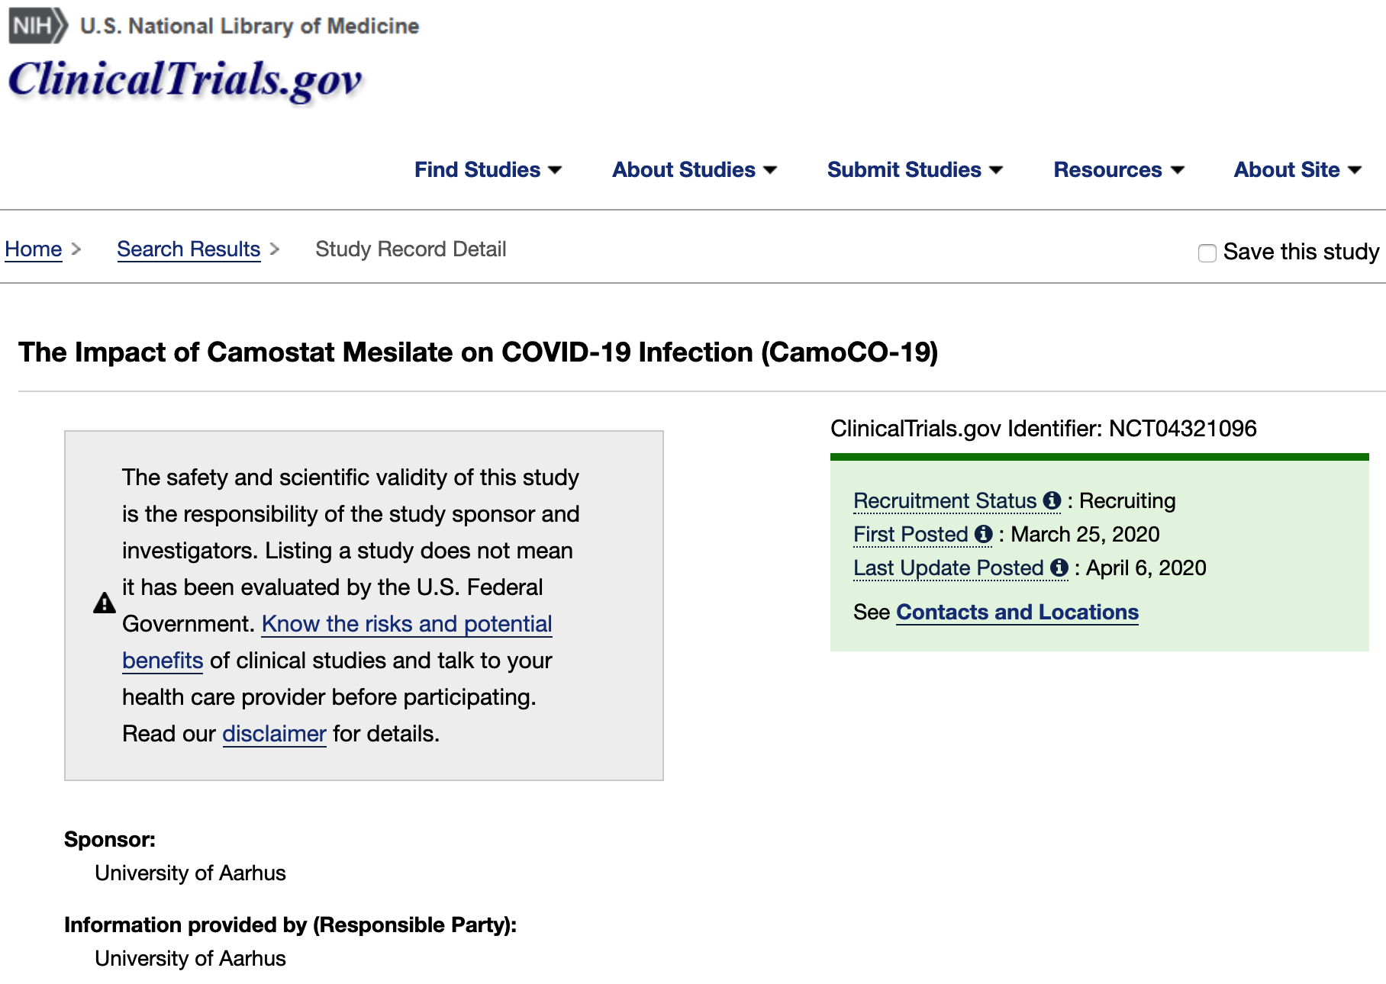
Motivating Examples (cont’d)
cysteine proteases cathepsin B and L (CatB/L)
Chloroquine
inhibit
inhibitor
inhibit
氯喹
treatment
氯化铵
is
is
camostat mesylate
Caco-2 cells
ammonium
chloride
partially
inhibit
is effective
in preventing
甲磺酸卡莫司他
entry
inhibit
inhibit
?
inhibit
TMPRSS2
drive
spread
ACE2
express
spike protein (S protein) _{SARS-2-S protein}
express
SARS-COV
infection
of
Vero
E6 cells
be
primary entry cells
SARS-COV-2
is
alveola
type 2 cells
express
lack
cells
entry receptor
enter
cells
not enter
CIDO (ontology)

Slide 11
Knowledge Graph 1: CoViz by AI2

Slide 12
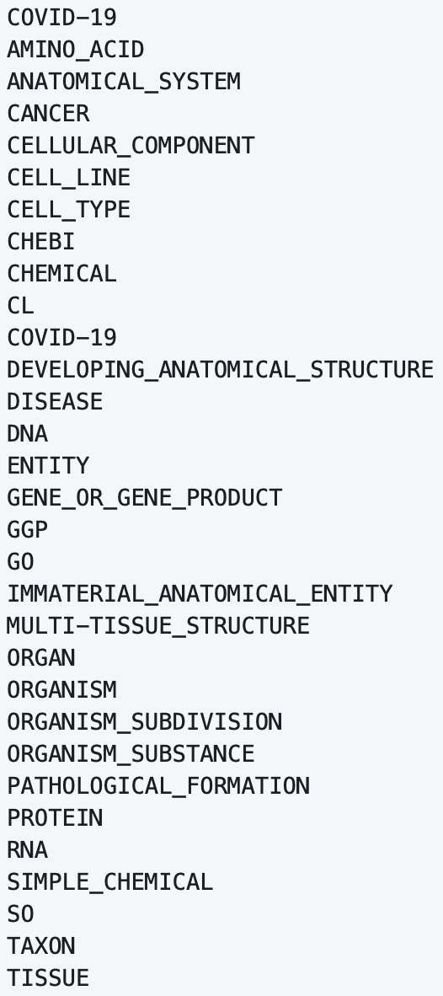
Knowledge Graph 2: SPIKE-CORD
NER
Relation
$causes
$treats
$uses
based on SciSpacy: SpaCy models for biomedical text processing
https://allenai.github.io/scispacy/
https://spike.covid-19.apps.allenai.org/search/covid19
https://spike.covid-19.apps.allenai.org/md/covid-usage-examples

Slide 13
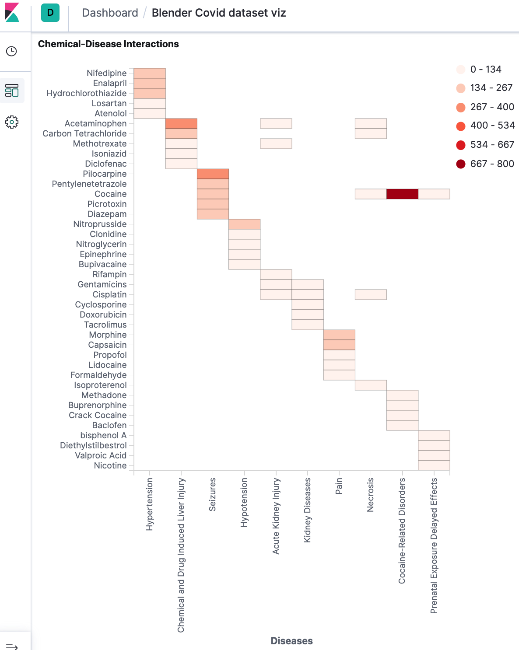
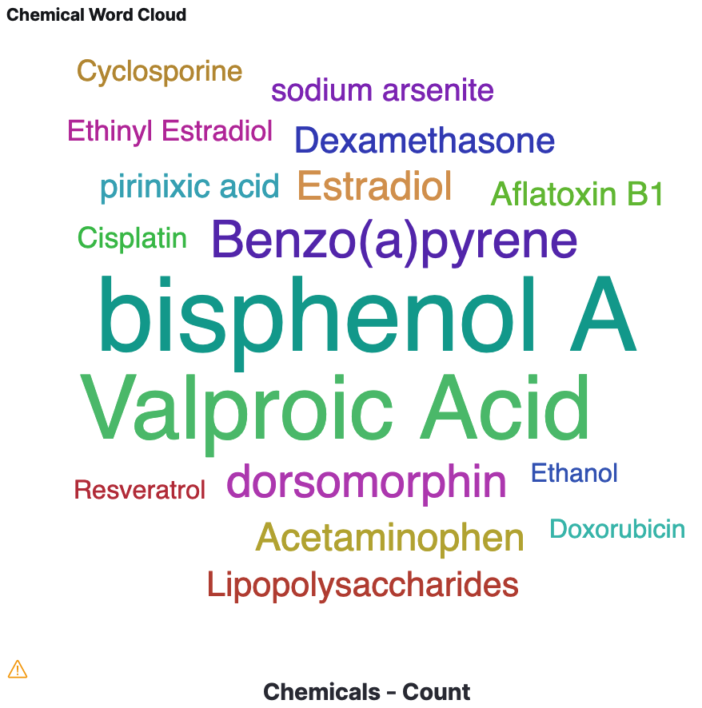
Knowledge Graph 3: Blender Covid + SemViz@Brendeis
http://blender.cs.illinois.edu/covid19/?fbclid=IwAR2z0BcjDWScjuiICaWQD-YrdZvtlGGQh3LNjvDi4JzzwU6G1K9HD4owYWE
https://www.semviz.org/

Slide 14
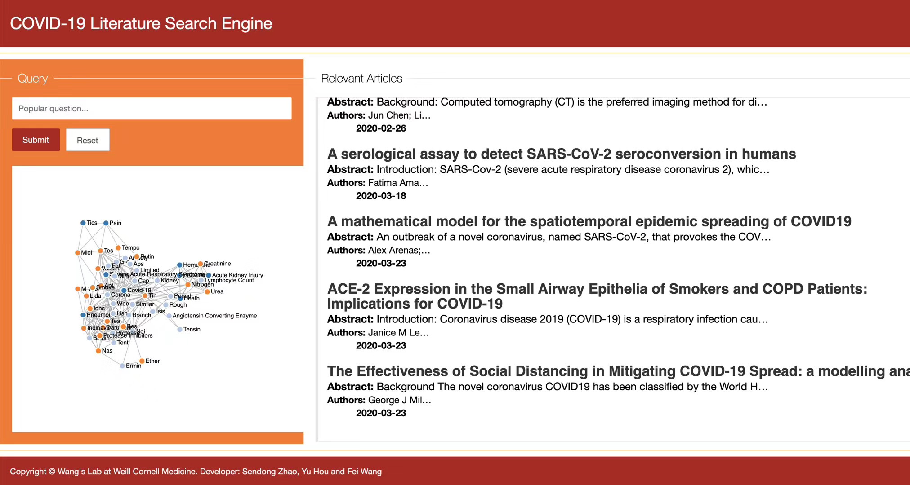
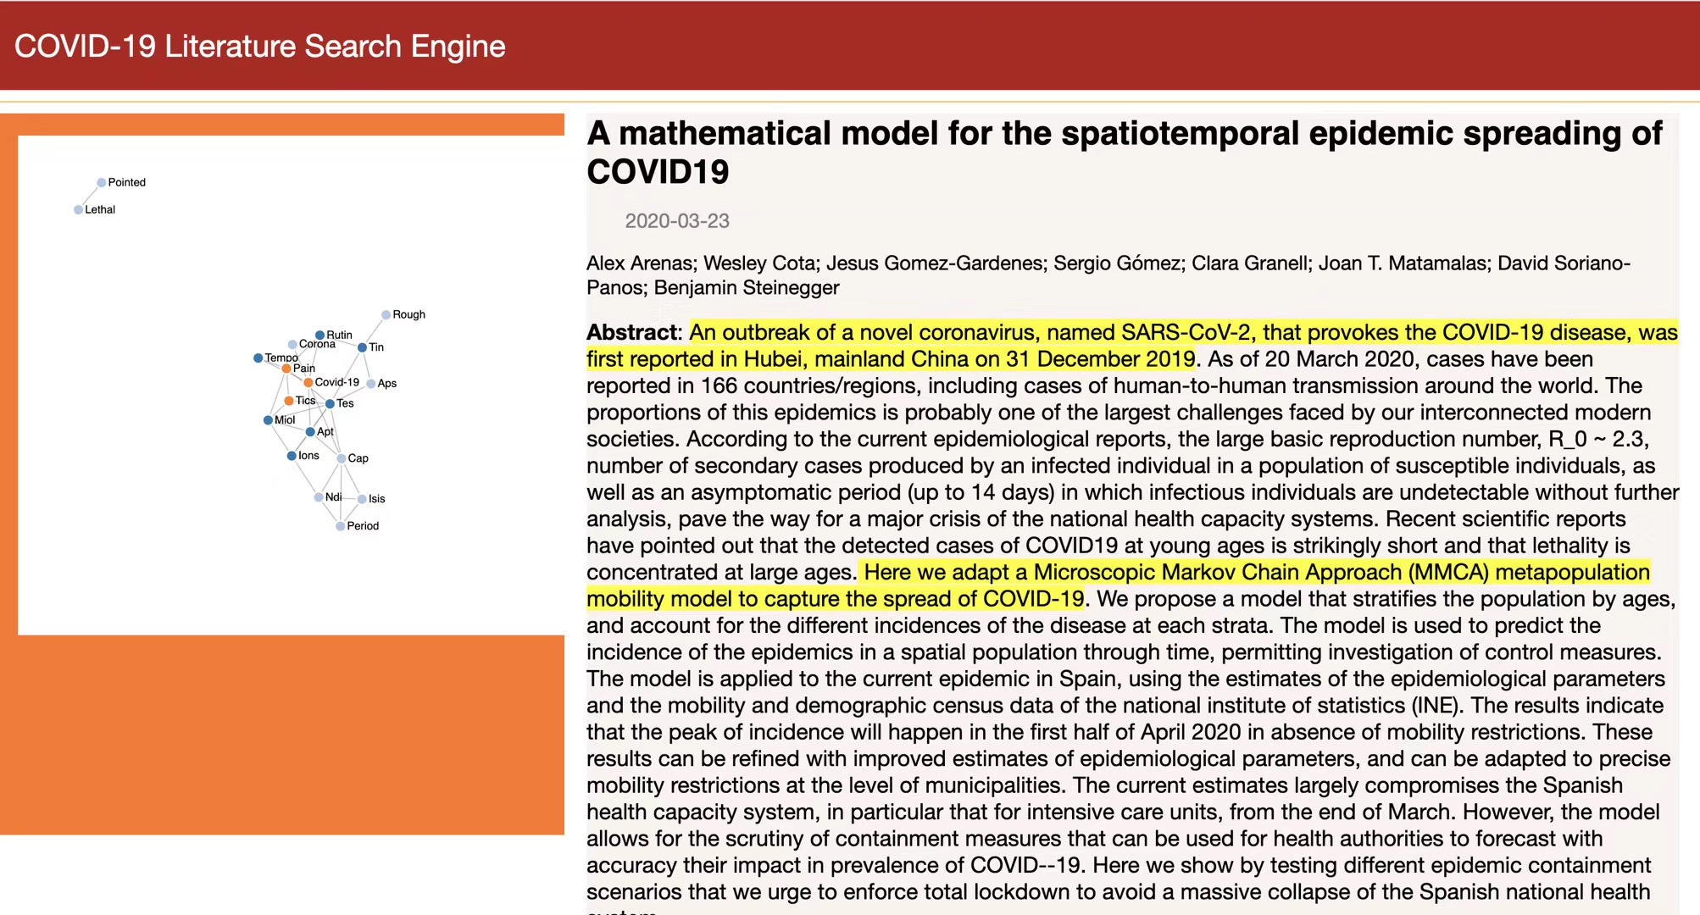
Knowledge Graph 4: Weill Cornell

Slide 15
Recommended Principles
P1: Relation-schema free: Open-domain IE with domain-specific pre-training?
P2: Attribute-aware: Quintuple: ({Esubj:::Asubj}, R, {Eobj:::Aobj})
Entities and noun phrases (attributes, etc.) and verbal phrases (relation), etc.
P3: Multi-tuple: One sentence can make multiple associated tuples
P4: Graph-oriented: Discovering knowledge by link/path prediction
“We showed that extracellular acidic pH reduces the activity of TRPV5/V6 channels, whereas alkaline pH increases the activity of TRPV5/V6 channels in Jurkat T cells.”
Fact tuple 1: (extracellular acidic pH, reduces, {TRPV5/V6 channels: activity})
Fact tuple 2: (alkaline pH, increases, {TRPV5/V6 channels: activity})
Condition tuple: (TRPV5/V6 channels, in, Jurkat T cells)

Slide 16
Roadmap
Scientific KGs of COVID-19 literature
Learning scientific KG for literature search
Learning scientific KG for text generation

Slide 17
Three-Layered Scientific KG

Slide 18
MIMO: An Information Extraction Model
Jiang T, Zhao T, Qin B, Liu T, Chawla N, Jiang M. Multi-Input Multi-Output Sequence Labeling for Joint Extraction of Fact and Condition Tuples from Scientific Text. EMNLP 2019.

Slide 19
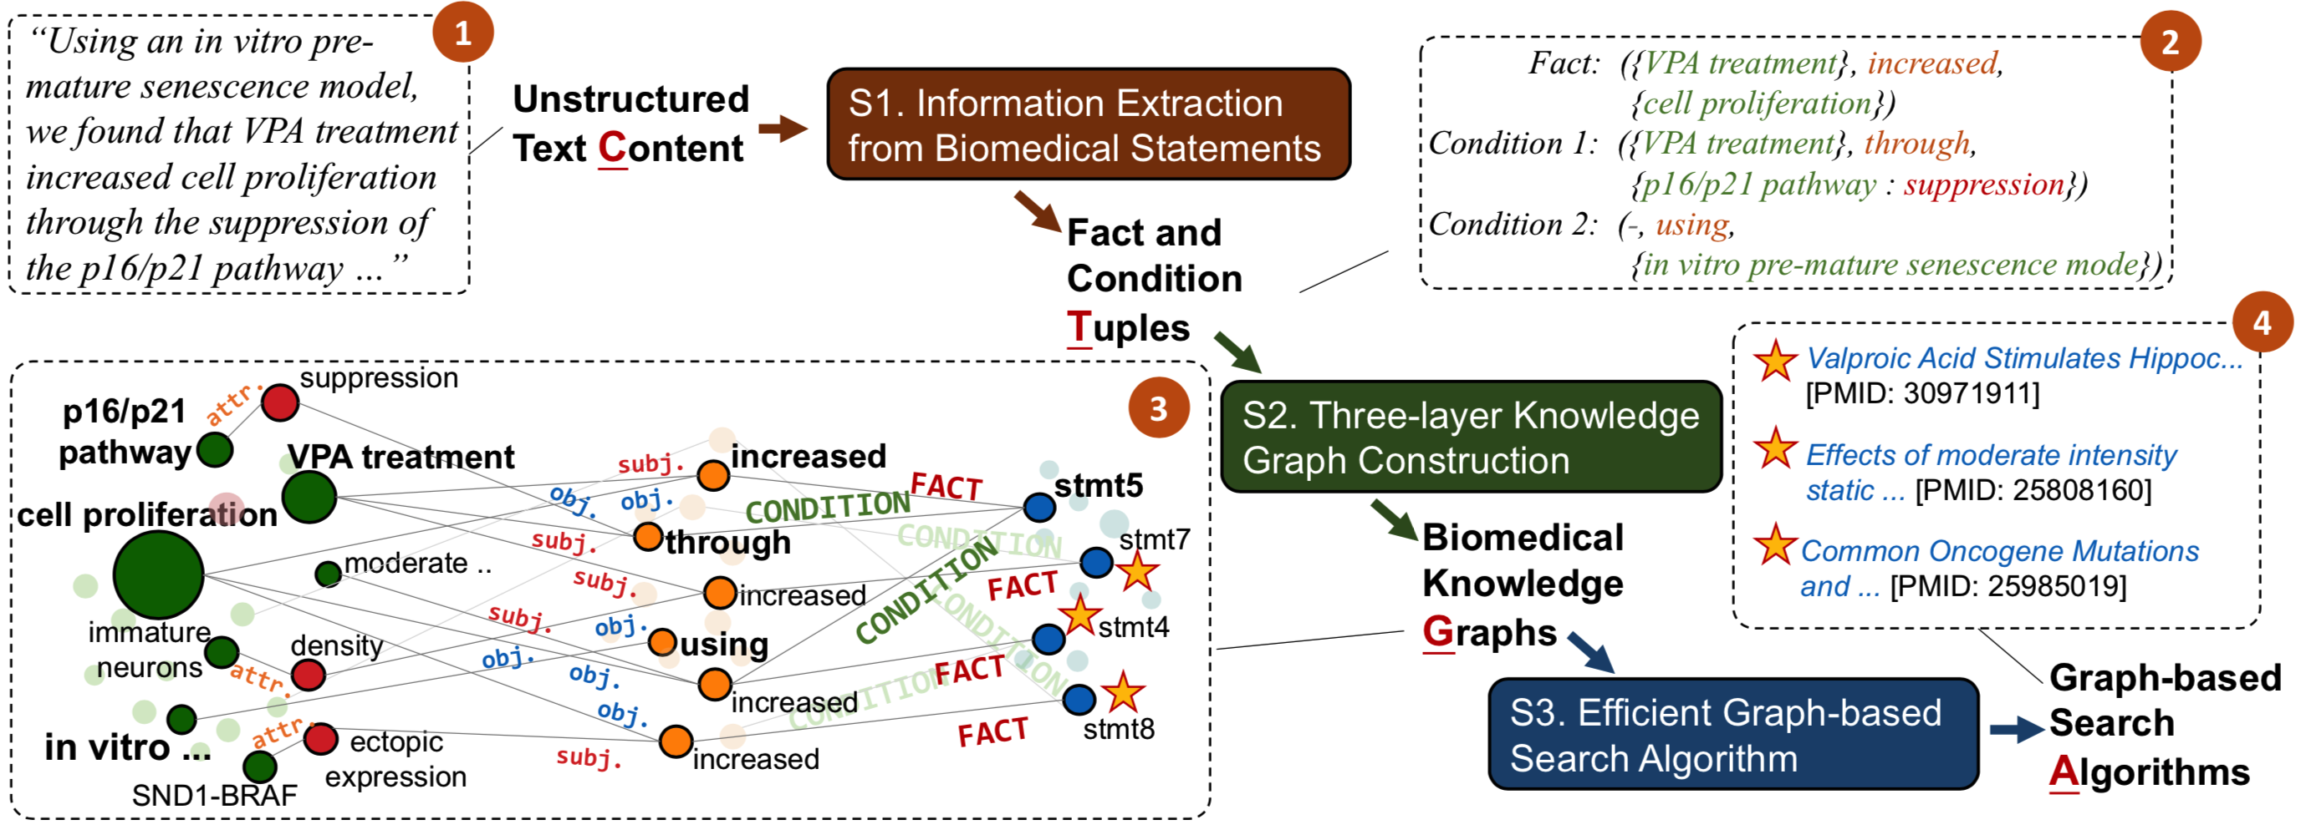
Novel Framework: CTGA
Search and knowledge discovery
Prediction and inference
Hypothesis generation
Hypothesis validation

Slide 20
A Demonstration System

Slide 21
Case Study

Slide 22
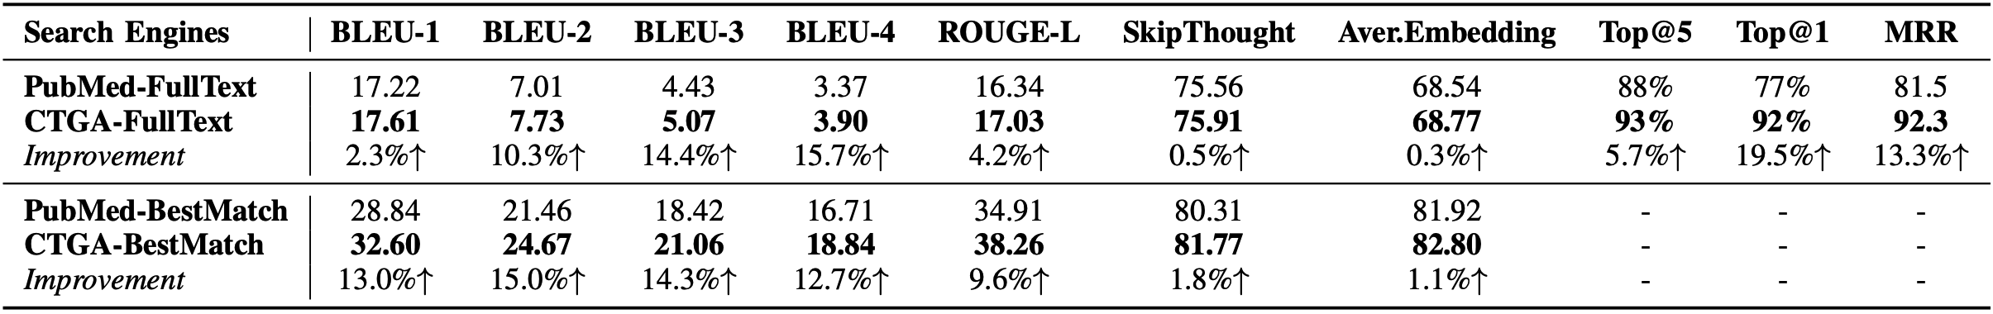
Results

Slide 23
Roadmap
Scientific KGs of COVID-19 literature
Learning scientific KG for literature search
Learning scientific KG for text generation

Slide 24
Three Interesting Works
MOLIERE: Automatic Biomedical Hypothesis Generation System (KDD’17)
PaperRobot: Incremental Draft Generation of Scientific Ideas (ACL’19)
Text Generation from Knowledge Graphs with Graph Transformers (NAACL’19)

Slide 25
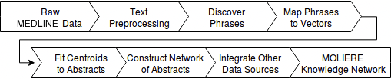
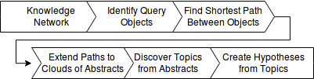
MOLIERE: Automatic Biomedical Hypothesis Generation System (KDD’17)
Network construction:
Query processing:

Slide 26
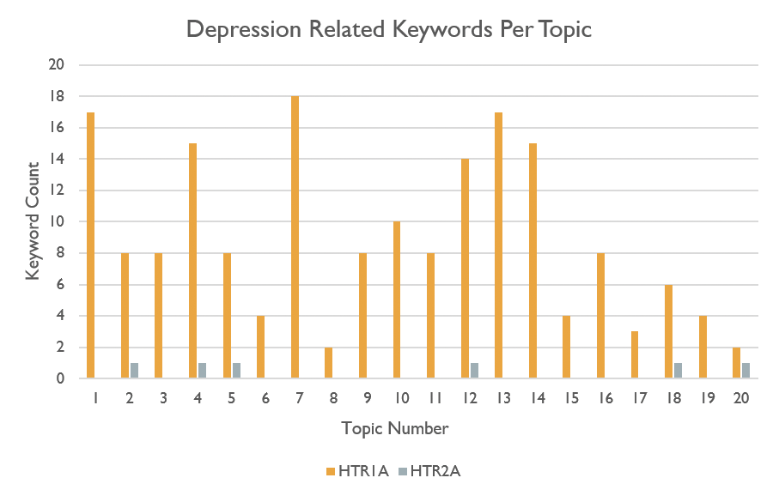
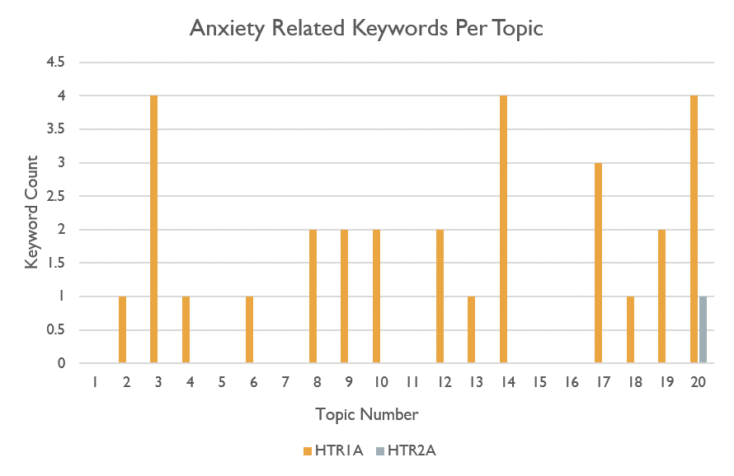
Results
As a result of running two queries, Venlafaxine to HTR1A, and Venlafaxine to HTR2A, we can corroborate the findings of Wang et al. in [49]. We find that neither pair of keywords is directly connected or connected through a single abstract. Nevertheless, phrases such as “long term antidepressant treatment,” “action antidepressants,” and “antidepressant drugs” are all prominent keywords in the HTR1A query. Meanwhile, the string “depress” only occurs four times in unrelated phrases with the HTR2A results. The distribution of depression related keywords from both queries can be see in figure 5.
Similarly, our results for HTR1A contain a single topic holding the phrases “anxiogenic,” “anxiety disorders,” “depression anxiety disorders,” and “anxiolytic response.” In contrast, our HTR2A results do not contain any phrases related to anxiety. The distribution of anxiety related keywords from both queries can be see in figure 6.
Our findings agree with those of Wang et al. which were that a small association score of 0.34 between Venlafaxine and HTR1A indicates a connection which is likely related to depressive disorder and anxiety. The association score between Venlafaxine and HTR2A, in contrast, is a much higher 4.0. This indicates that the connection between these two keywords is much weaker.

Slide 27
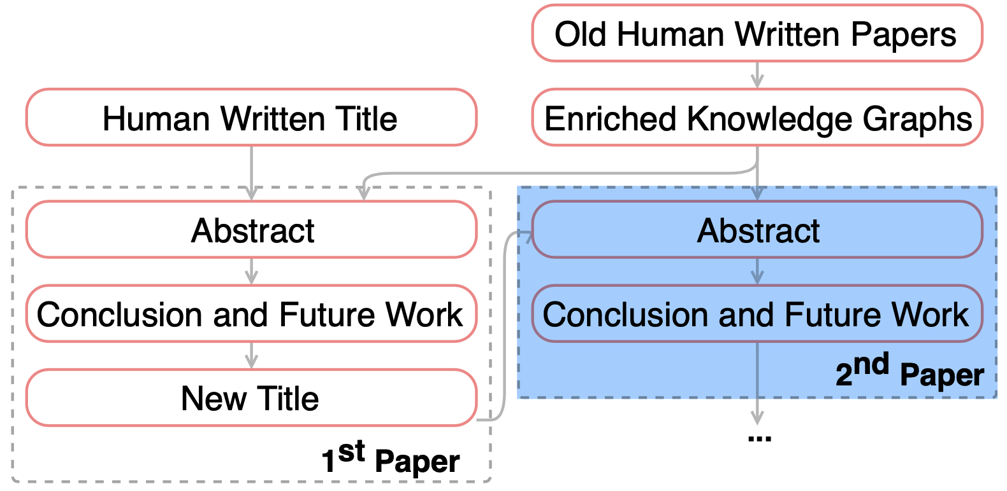
PaperRobot: Incremental Draft Generation of Scientific Ideas (ACL’19)
Incremental writing

Slide 28
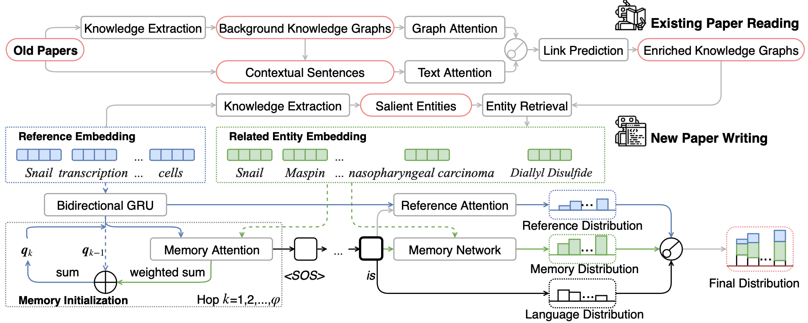
Architecture Overview

Slide 29
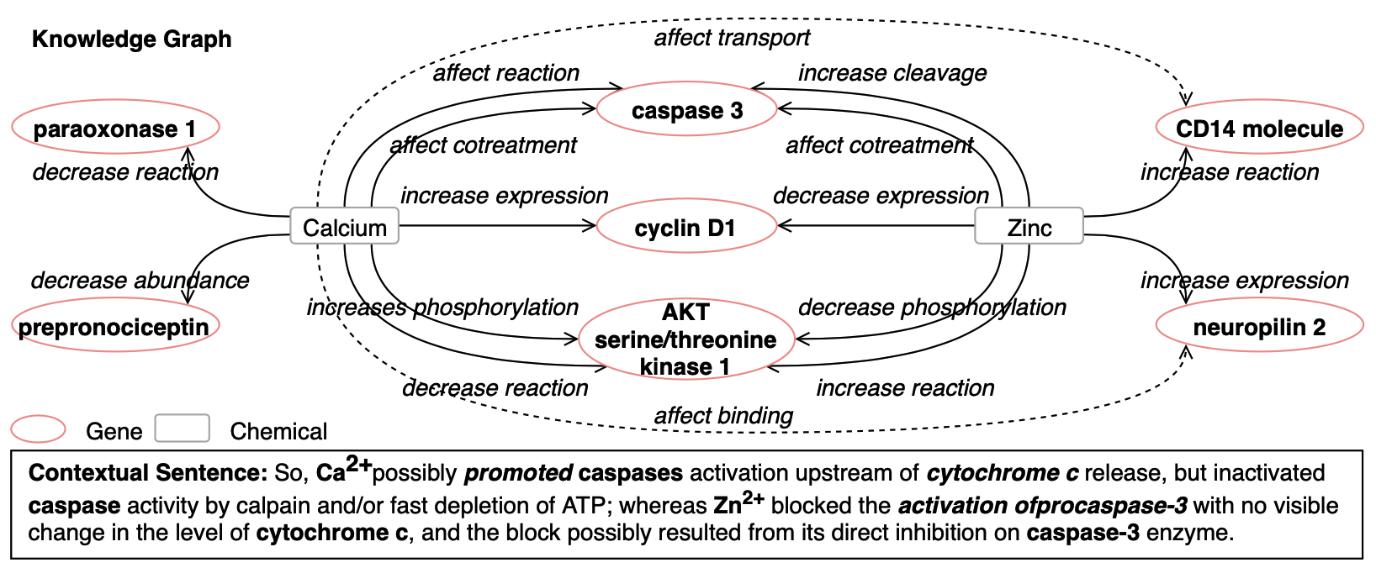
Biomedical Knowledge Extraction and Link Prediction

Slide 30
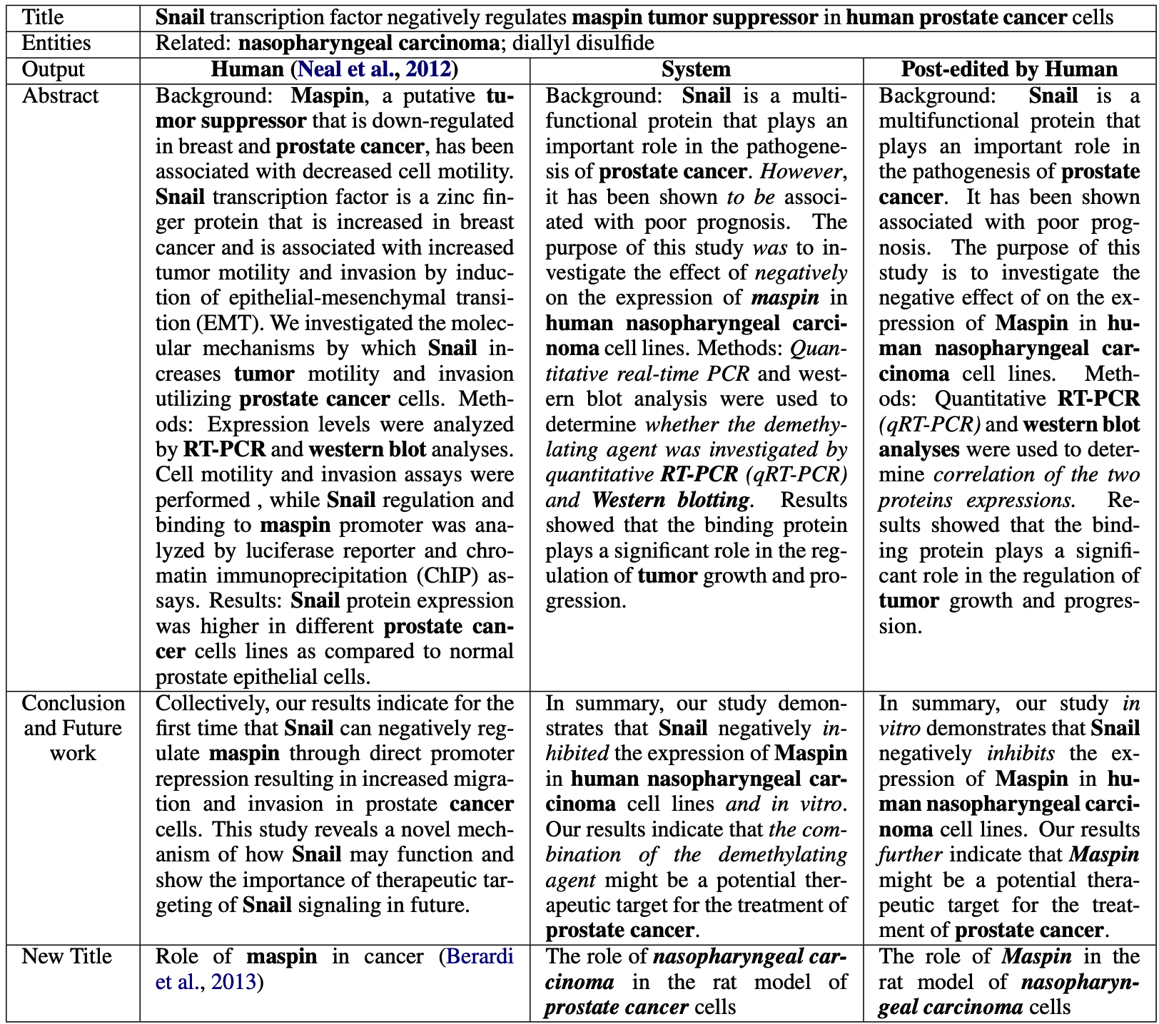
Results

Slide 31
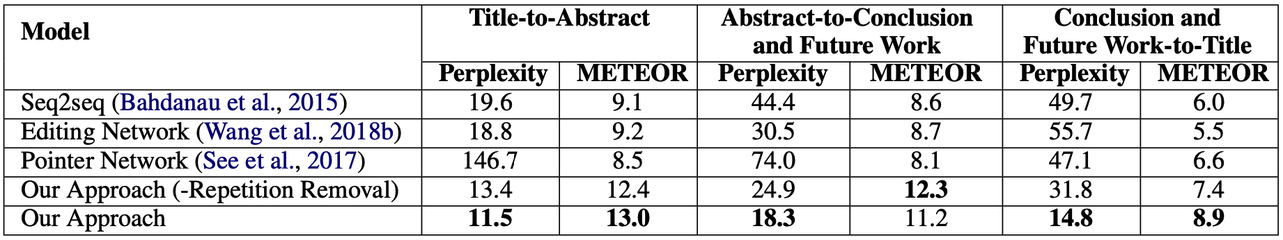
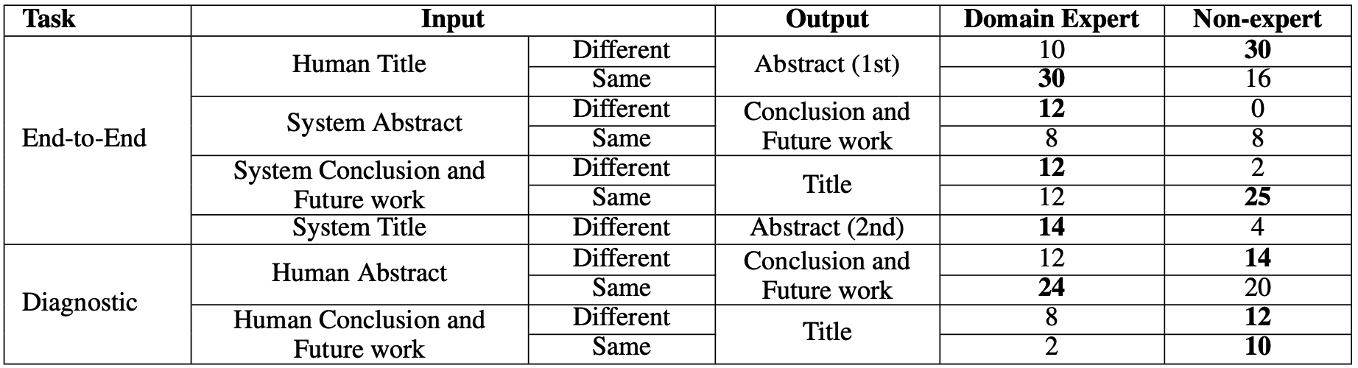
Results (cont’d)

Slide 32
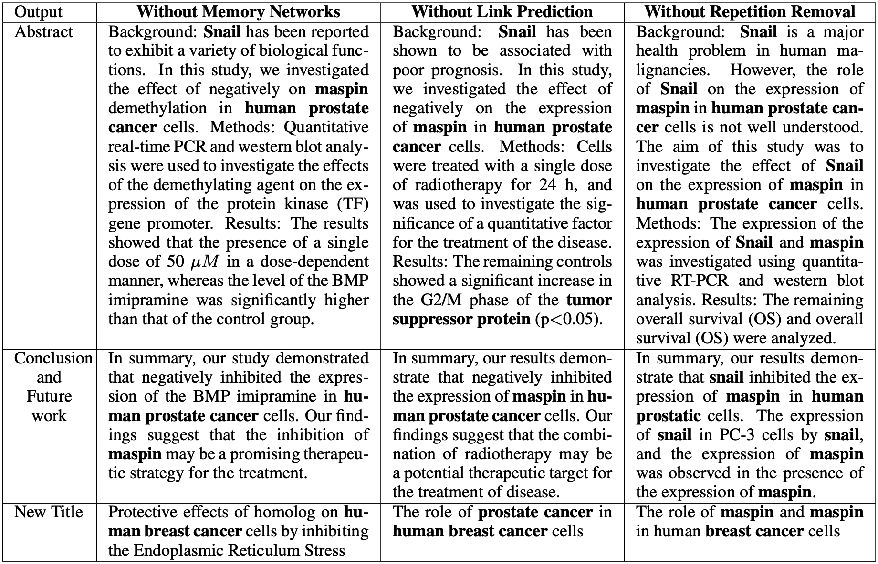
Results (cont’d)

Slide 33
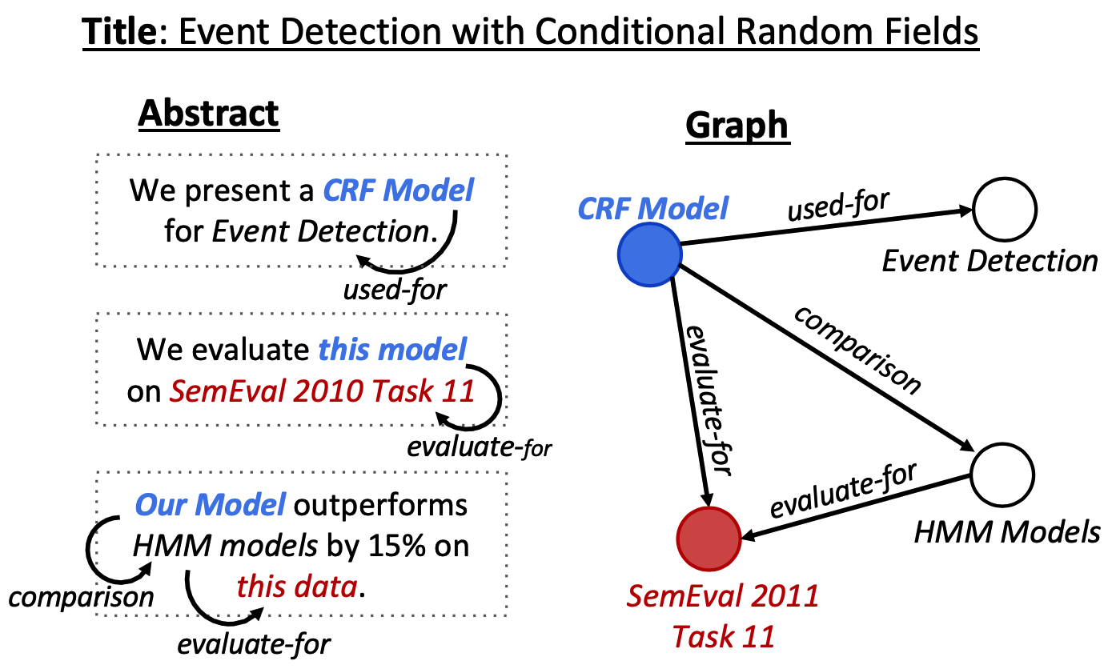
Text Generation from Knowledge Graphs with Graph Transformers (NAACL’19)
Text-to-graph extraction
Graph-to-text generation

Slide 34
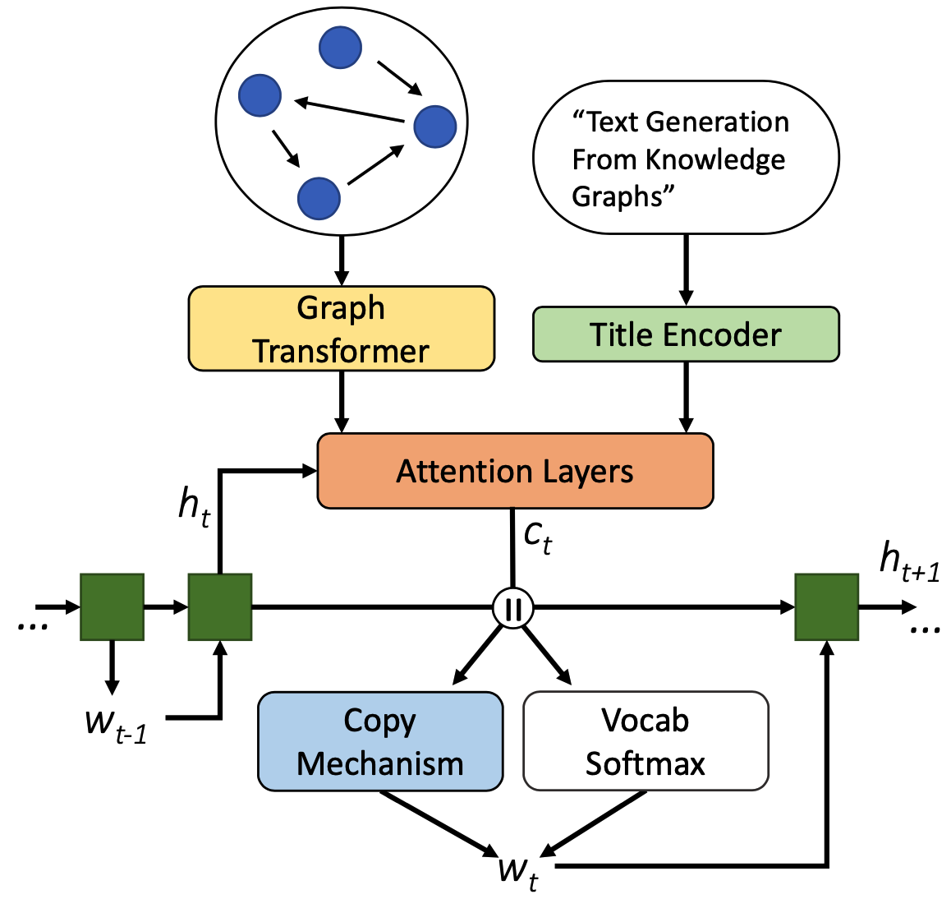
Graph Writer Model

Slide 35
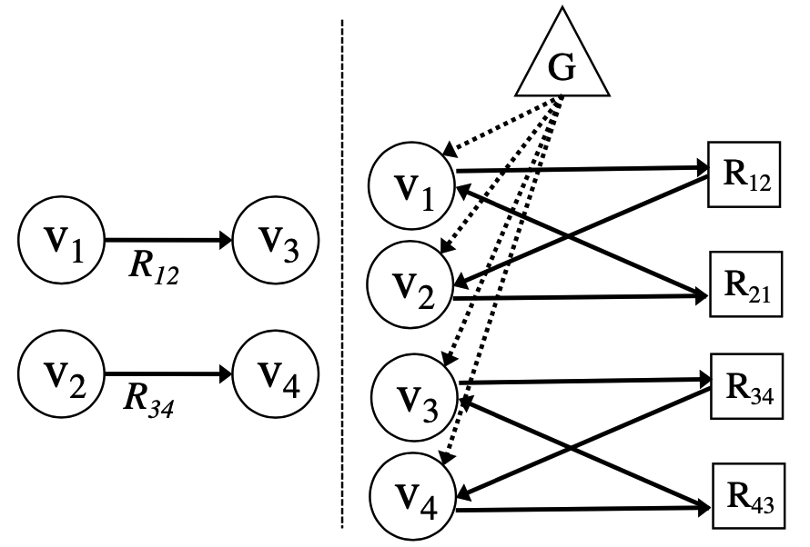
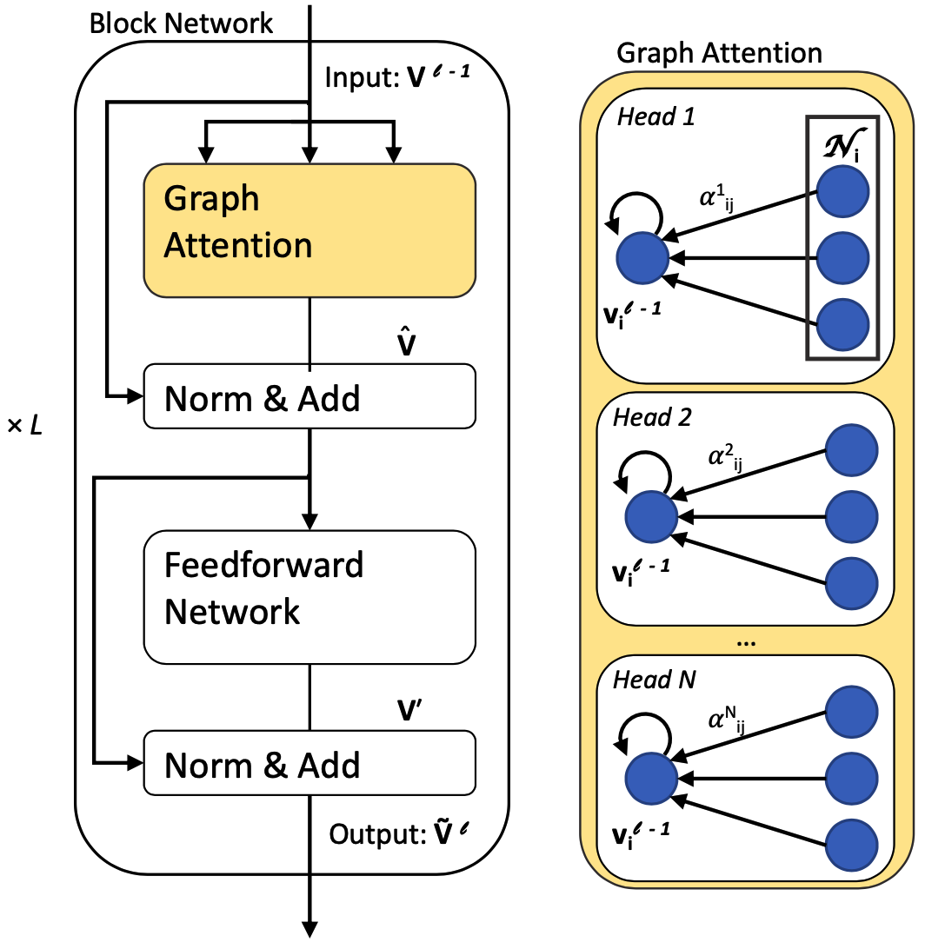
Graph Attention and Graph Transformer
Converting disconnected labeled graph to connected unlabeled graph for use in attention-based encoder.
v_{i} refer to vertices, R_{ij} to relations, and G is a global context node.
Graph Transformer

Slide 36
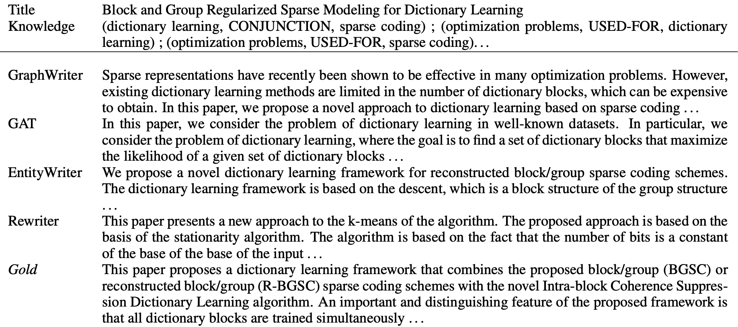
Results

Slide 37
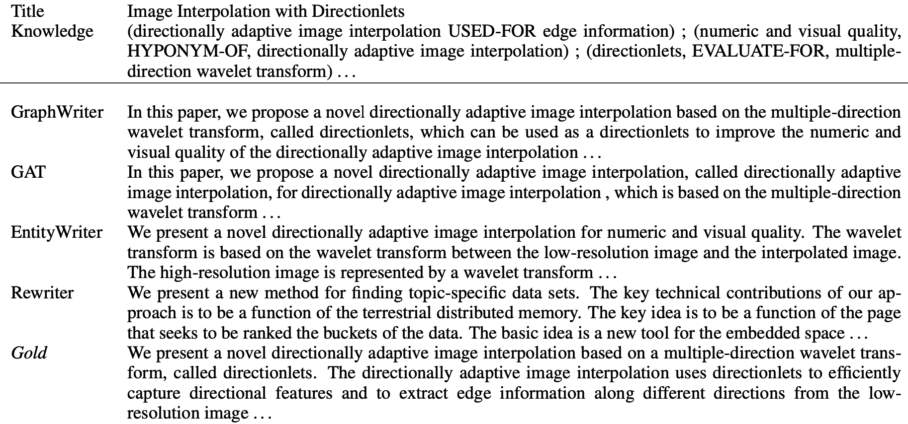
Results (cont’d)

